Slide 1
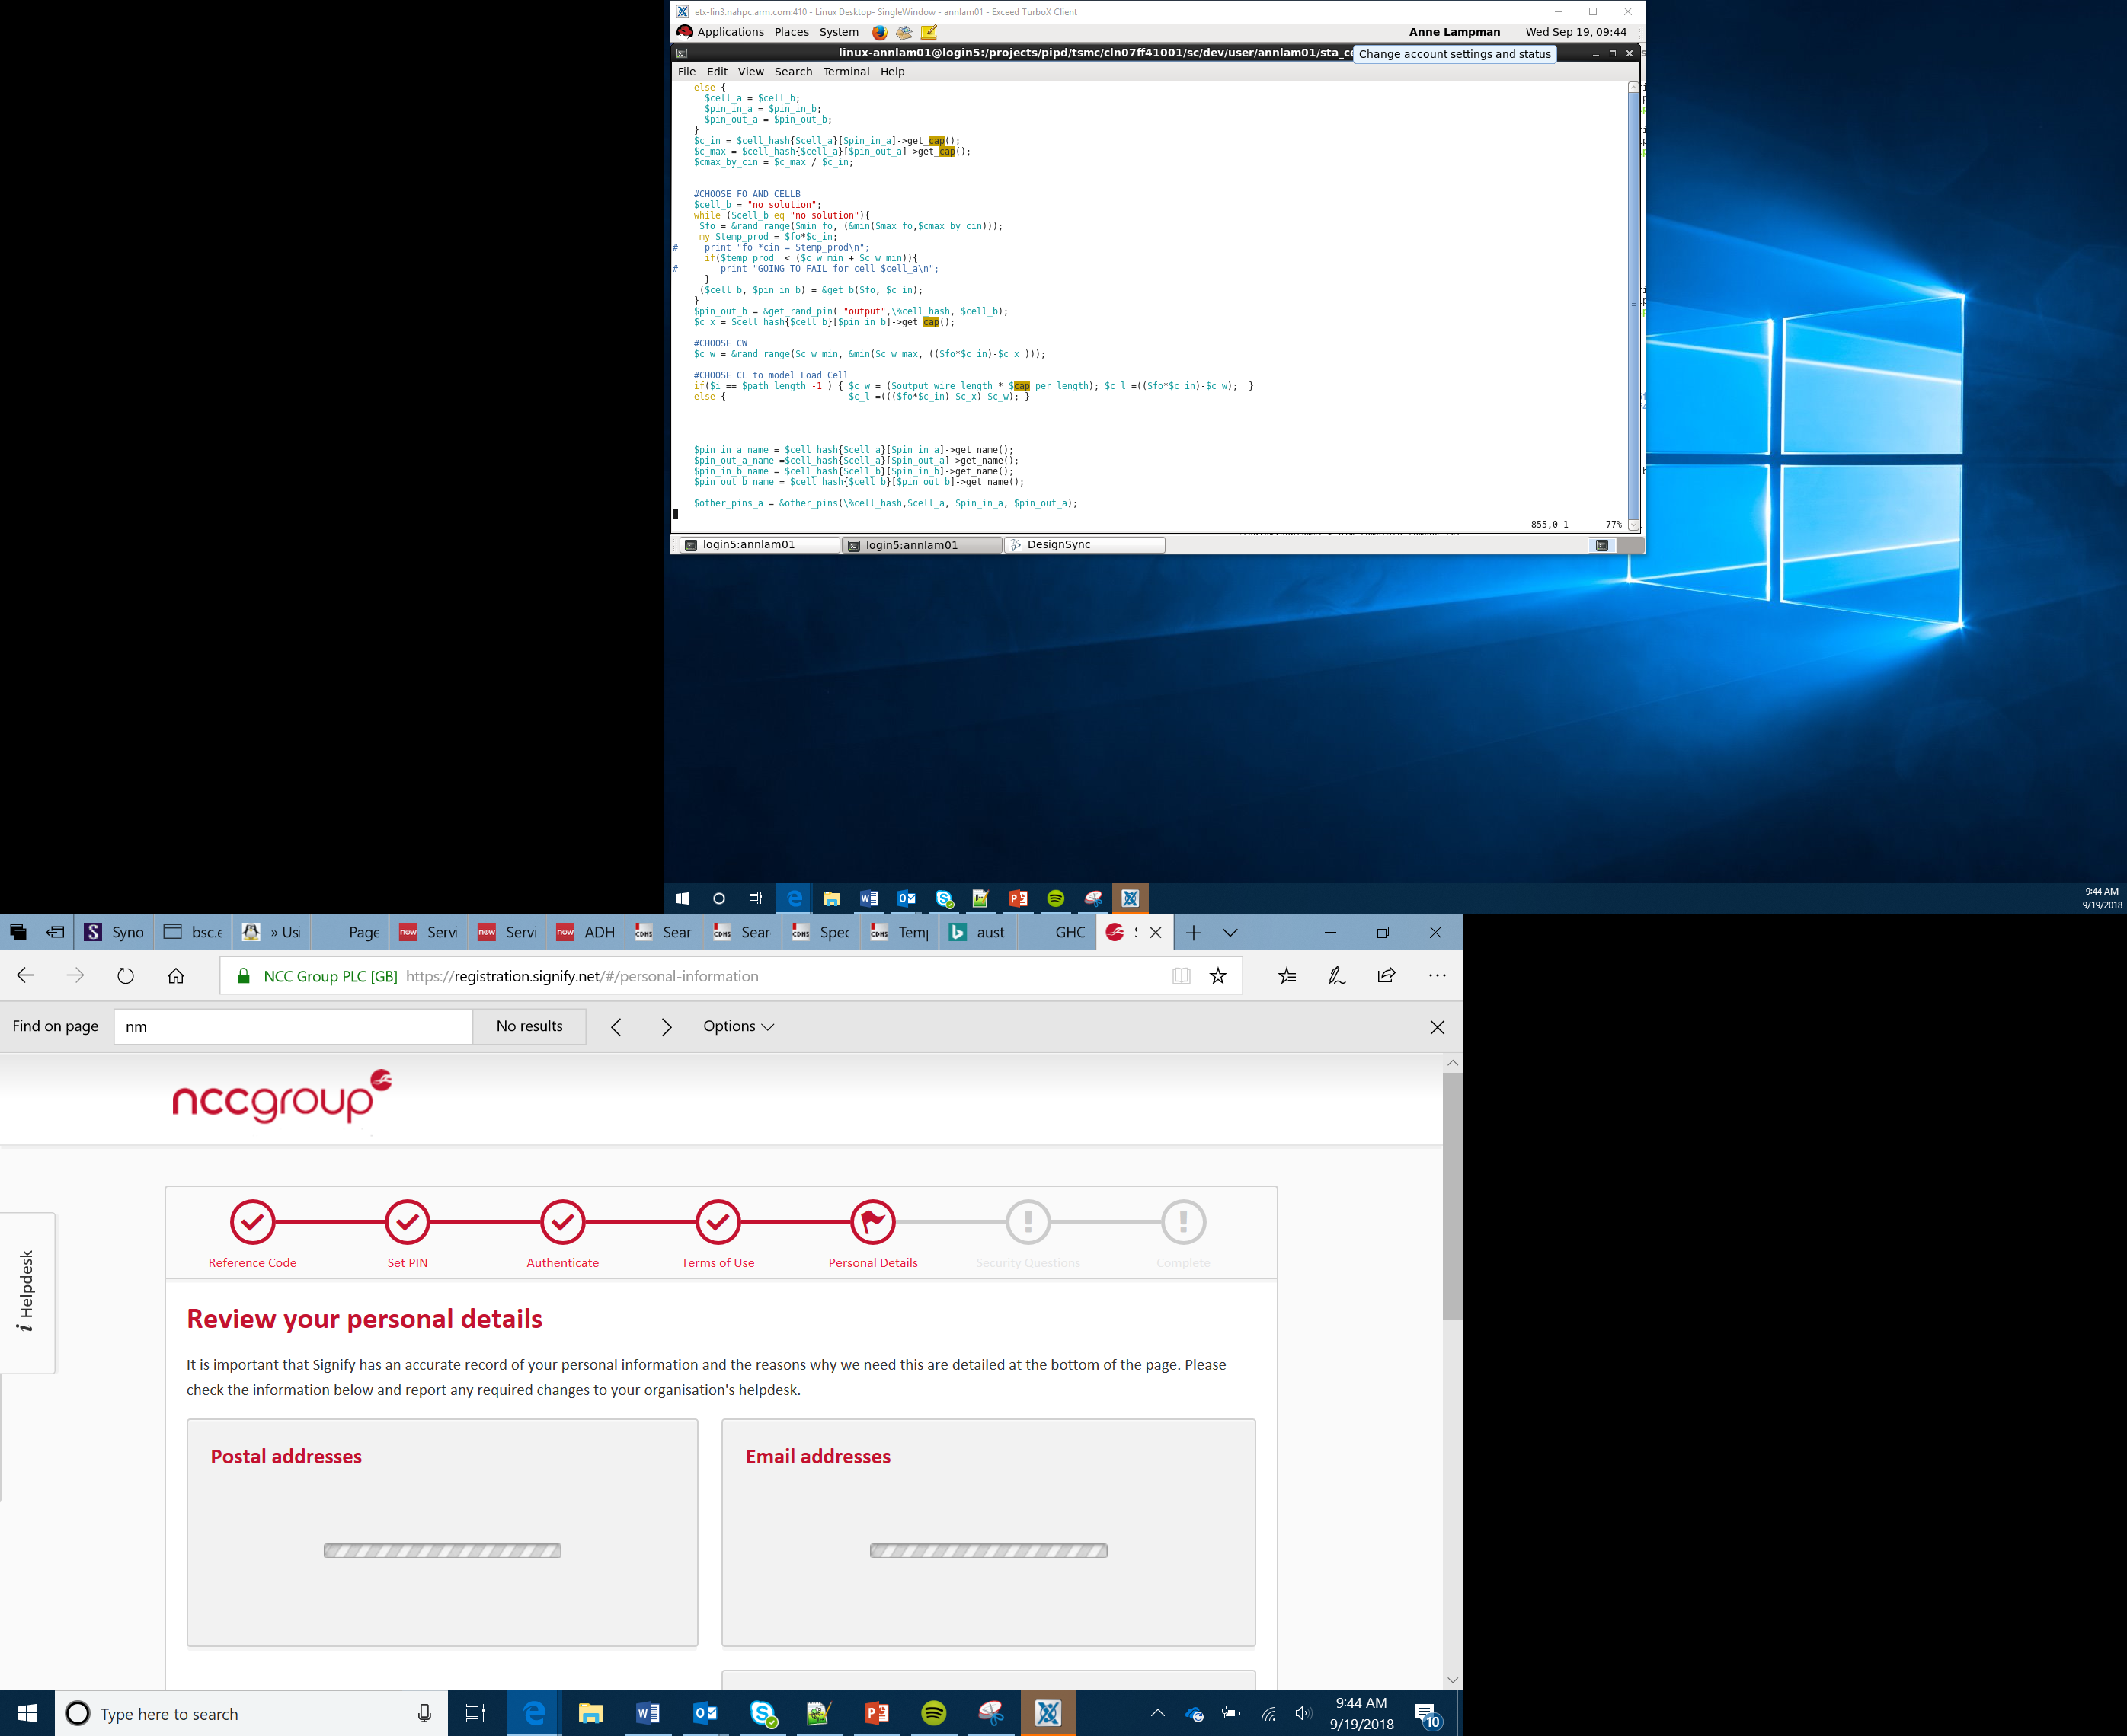

Maths Quiz Project
Lessons 5–6

Slide 2
Project Based Learning
Project based learning will allow you to explore new concepts through practical activities
These are larger projects than the practical tasks which require you to plan and develop a solution
Some projects will be completed in pairs although this initial one will be completed individually
When you are given the project you will start by identifying what your solution will need to do
You will use success criteria to do this
Project
Plan
Develop
Test
Evaluate
Notes:
Introduce the concept of project based learning. Learners will often complete these tasks in pairs. In this initial project learners will work individually so that they fully understand the process. Initially learners will plan their project through the use of success criteria. They will then produce their solution, check that it works and then evaluate the process that they have followed and whether anything could be done differently in the future.

Slide 3
Success Criteria
Success criteria should be identified before starting to produce the solution
The success criteria will state what the product should do once it has been created
Initially you should read the task and then split it up into a number of criteria that you can measure
At the end of the project, you will evaluate your product against the success criteria that you have identified
Is my project
a success?
Notes:
The purpose of identifying success criteria at the start of a project is to split up the overall task into a number of individual, measurable steps. At the end of the project learners will assess their solution against their success criteria. This will help them to determine whether the project has been a success.

Slide 4

Maths Quiz
Over the next two lessons you are going to create a maths quiz which can be played on the micro:bit
What success criteria should we define for our maths quiz?
This Photo by Unknown Author is licensed under CC BY-ND

Slide 5

Variables
Variables are like empty boxes which allow us to temporarily store data in
In a computer system they are named locations in memory which allow computers to store data
If we wanted to store your first name we could take a box and name it ‘firstName’. You could then store your first name in that box.
In a maths quiz, what variables do you think will need to be used?
This Photo by Unknown Author is licensed under CC BY-SA-NC
Notes:
When learners produce their maths quiz they will need to store a couple of items of data, int1 and int2. In a computer program we can store data as a variable which is a named location in memory. We can give those locations names and then store data within them.

Slide 6
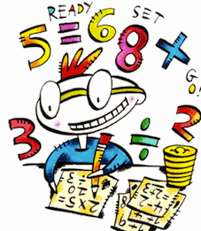
Maths Quiz
Your task is to produce a maths quiz on the micro:bit
You need to create a case for the micro:bit on the theme of maths that:
Has decoration relating to what it will do
Uses the template provided
You should aim to complete the case by the end of this lesson
In the next lesson you will work through the tutorials to create the actual maths quiz
This Photo by Unknown Author is licensed under CC BY-NC-ND

